Slide 1
Logic Analyzer

Slide 2
The analyzer can sample many different signals simultaneously but can display only 0, 1, or changing values for each.
All these logic analysis channels can be connected to the system to record the activity on many signals simultaneously.
The logic analyzer records the values on the signals into an internal memory and then displays the results on a display once the memory is full or the run is aborted.
The logic analyzer can capture thousands or even millions of samples of data on all of these channels, providing a much larger time window into the operation of the machine than is possible with a conventional oscilloscope.
A typical logic analyzer can acquire data in either of two modes that are typically called state and timing mode

Slide 3
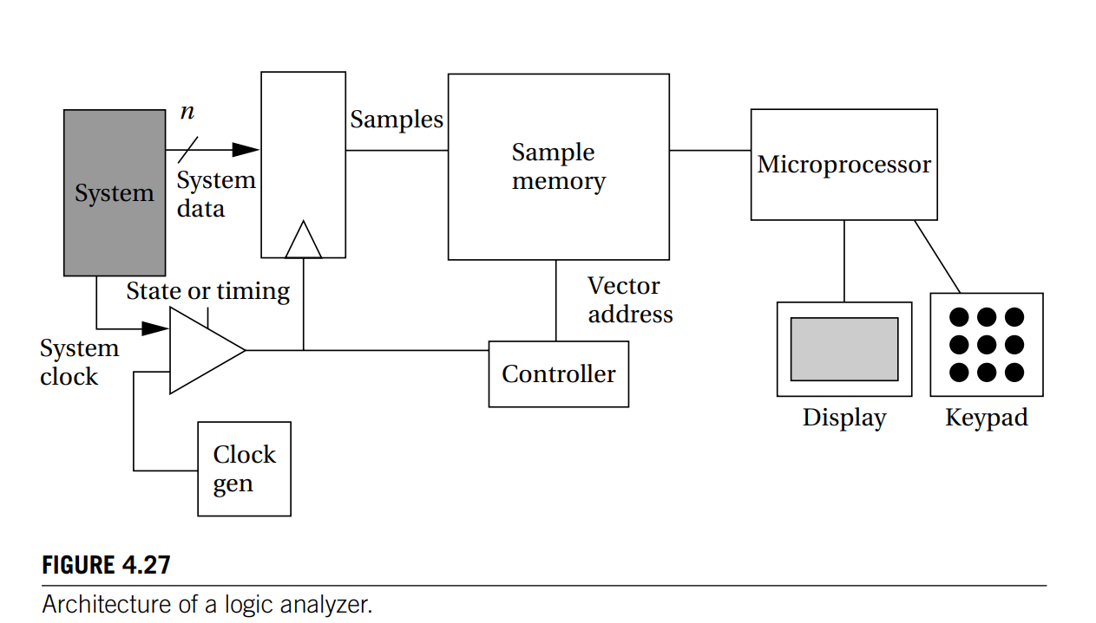

Slide 4
The system’s data signals are sampled at a latch within the logic analyzer;
the latch is controlled by either the system clock or the internal logic analyzer sampling clock, depending on whether the analyzer is being used in state or timing mode.
Each sample is copied into a vector memory under the control of a state machine.
The latch, timing circuitry, sample memory, and controller must be designed to run at high speed since several samples per system clock cycle may be required in timing mode.
After the sampling is complete, an embedded microprocessor takes over to control the display of the data captured in the sample memory.

Slide 5
Logic analyzers typically provide a number of formats for viewing data. One format is a timing diagram format.
Many logic analyzers allow not only customized displays, such as giving names to signals,but also more advanced display options.
For example, an inverse assembler can be used to turn vector values into microprocessor instructions.
The logic analyzer does not provide access to the internal state of the components, but it does give a very good view of the externally visible signals.
That information can be used for both functional and timing debugging

